Slide 1

StockWatch
Chenson Johnson, Binju Shrestha, Samuel Khalil, David Osterhoff, Yunfan Yang, Zheng Zeng, Zhuoming Lei

Slide 2
Overview Sprint 3
We hosted our app on pythonanywhere web server
http://chenson.pythonanywhere.com/
We updated our html design as well as formatted our layout so that it looks good on a personal computer as well as mobile phone
We continued our quality assurance test on the website

Slide 3
Backend User Stories
Create a database schema to store stocks data.
Receive .CSV files of historical data from ALG team store data under its proper table
Receive Training data, Test data from ALG team and store it under its proper table
Give the UI team access to the data to plot

Slide 4
User Interface
User Stories
From a drop down list the user should be able to select which stock to run the experiment on. We are gonna have 5 options for now (Yahoo, Google etc)
From a drop down list the user should be able to select which algorithm to run the experiment on.
After the user selects the stock and algorithm there should be a button called Plot to plot the data.
For each graph we will have 3 lines (Historical data, Training data (from which algorithm), Test data (from which algorithm))

Slide 5
Algorithm Team
User Stories
Create experiment algorithms (6 of them so far we have 1)
Receive data from backend team and split data to training data and test data
Create an algorithm to turn the training data and test data to numpy format
Run experiments and convert the .Json file to .CSV give backend team a .CSV file for each experiment

Slide 6
Challenges
Integrating charts into front end
due to nature of how the program works right now, it will be challenging to get extract the graphs from each test
Getting historical data from web page - Automatically download historical data when analyze stocks.
Notes:
it will be hard to integrate the charts since the program generates a different folder each time the program is run. we will havve to dynamically find the new folder each time or save the graph in a specific folder

Slide 7
Machine Learning Challenges
Steep Learning curve
Getting the machine to learn
Program will generate weights and rewards, but doesn’t want to look at it again
Speed
It takes a long time (30+ minutes) to properly test the algorithm

Slide 8
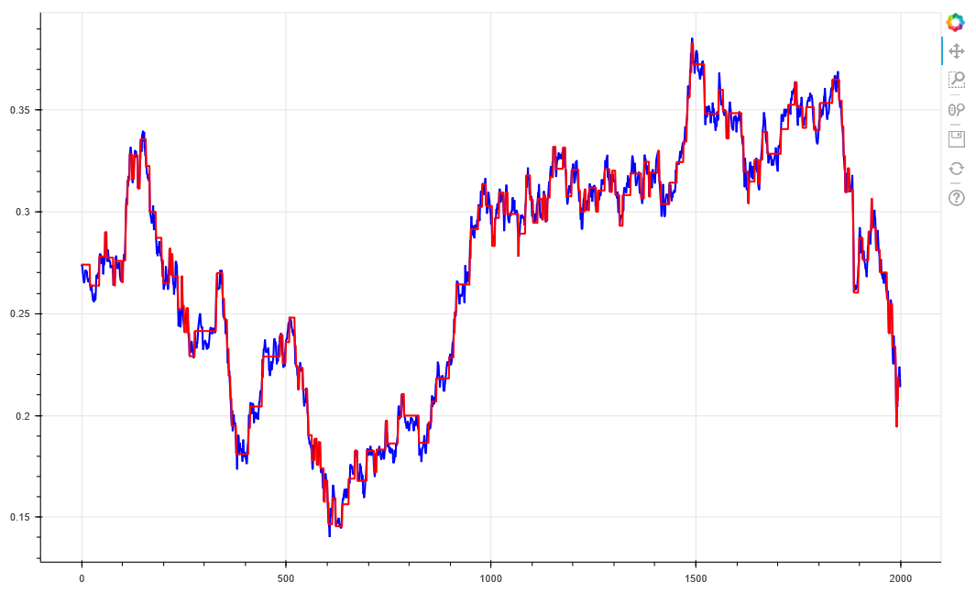
Imported Data
Blue Lines = Stock Price
Red Lines = Agent Trail
Trail History

Slide 9
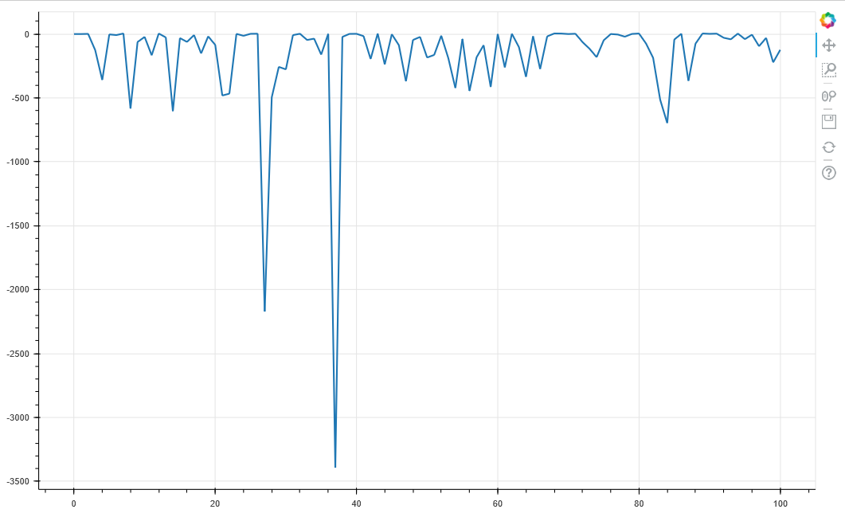
The Agent’s reward values.
The higher the number, the better it is at prediction.
Negative numbers mean that the algorithm isn’t doing well.
Reward Values

Slide 10

Demo

Slide 11
Upcoming Sprint
We want to fine tune the machine learning and implement it into the front end.
We want to find/generate reliable datasets for stock market analysis

